Slide 1
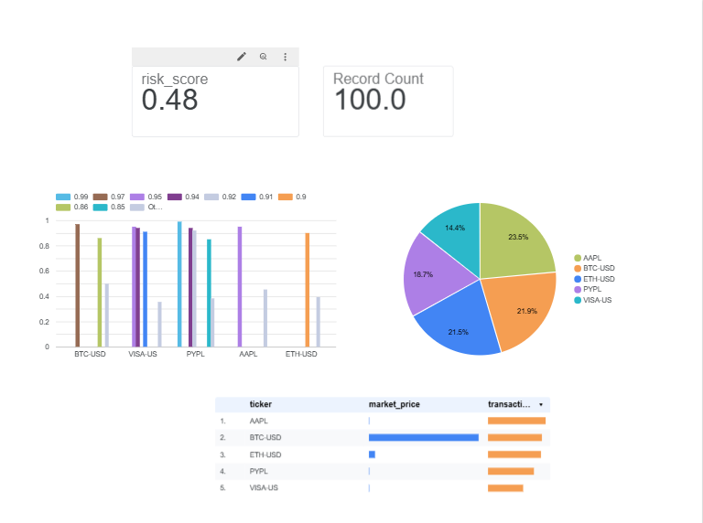
FinTech Cloud Data Ingestion & Portfolio Risk Analytics Engine
PORTFOLIO CASE STUDY
An automated pipeline that moves simulated multi-asset market data from Python into BigQuery, adds a Gemini-written executive summary, and delivers live Looker Studio dashboards. It replaces multi-step manual risk reporting with a one-click run.
Live Looker Studio dashboard built on BigQuery
Supriya
Business Analyst | Data Analyst
Notes:
Introduce yourself, the project name, and the one-line value: automated FinTech risk analytics from raw data to executive dashboard.

Slide 2
Tools Used to Automate & Why It Matters
1
Python + Pandas
Why automate?
Simulates the market stream and computes risk metrics
Google BigQuery
Speed
2
Hours of manual reporting become a single click.
Scalable cloud data warehouse for all records
Accuracy
3
IAM Service Account
No manual copy-paste or spreadsheet regrouping.
Secure JSON-key access to the warehouse
Scale
4
Gemini 1.5 Flash
2.5M+ volume units processed with no manual effort.
Writes the plain-English executive summary
Consistency
5
Looker Studio
The same trusted logic runs on every refresh.
Live dashboards for leadership
Notes:
Walk through each tool and what job it does, then explain why automation matters for a business: speed, accuracy, scale, consistency.

Slide 3
The Business Case: Manual vs Automated
Before: manual
After: automated
Ad-hoc SQL queries written for every request
Manual spreadsheet grouping and cleanup
Hours of lag before leadership sees numbers
Hard to repeat and easy to get wrong
1 click
Pipeline runs end to end with one command
BigQuery to Pandas to Gemini to Looker Studio
Executive summary written in plain English
Live dashboard always reflects the warehouse
replaces multi-step manual reporting
query to dashboard
Notes:
Contrast the old manual process with the automated one. Add your own measured numbers here, for example how long the manual report took versus one run.

Slide 4
End-to-End Pipeline Architecture
1
2
3
4
5
Ingest
Store
Analyze
Summarize
Visualize
Python engine simulates a live market stream: BTC, ETH, AAPL, PYPL, VISA.
›
BigQuery warehouse, secured with an IAM service account and JSON key.
›
Pandas computes exposure, anomaly rates and whale-trade alerts.
›
Gemini 1.5 Flash turns the metrics into an executive summary.
›
Looker Studio dashboards connect directly to BigQuery.
Data governance
Warehouse calculation layers are kept separate from public AI endpoints to limit data exposure.
Notes:
Five stages, left to right. Highlight Gemini as the GenAI layer and the governance point at the bottom.

Slide 5
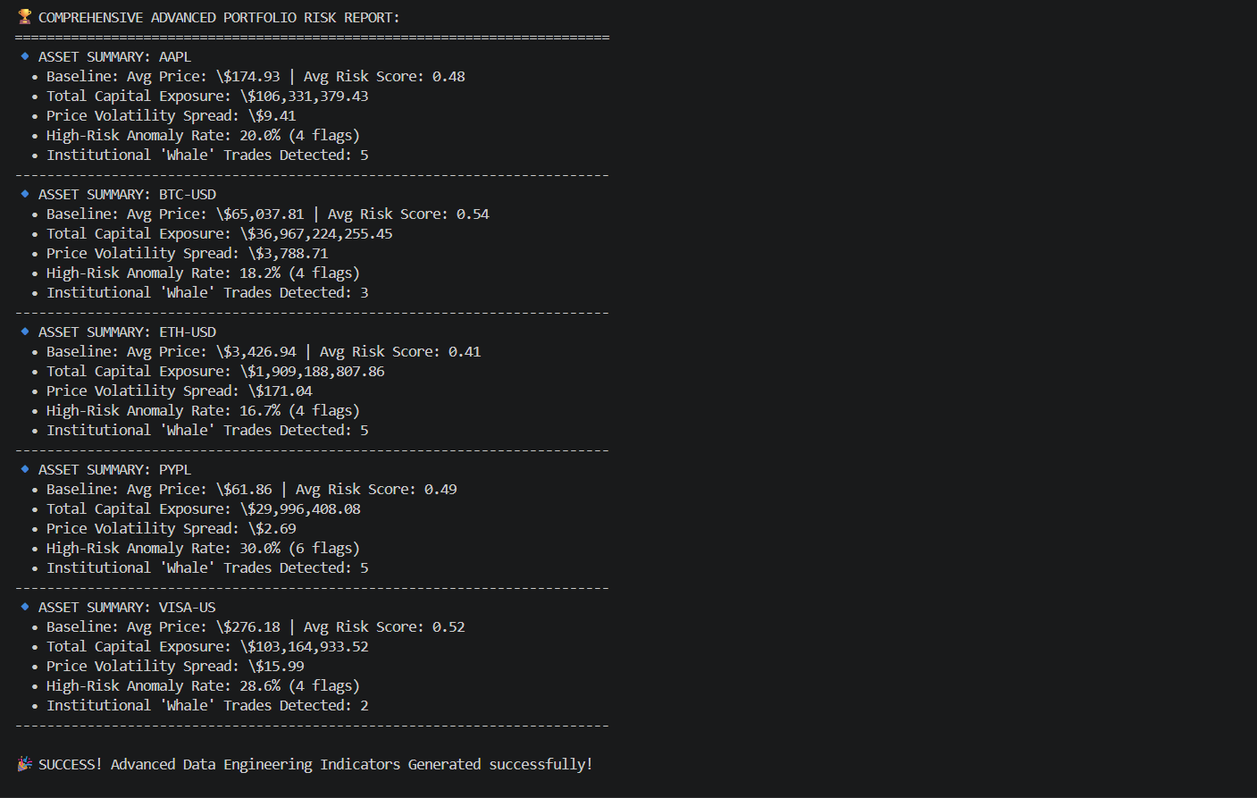
Phase 1: Advanced Portfolio Risk Report
$36.97B
BTC-USD capital exposure, the largest in the portfolio
30.0%
PYPL high-risk anomaly rate (6 flagged records), the highest of 5 assets
20
institutional whale trades detected across all assets
Terminal output: per-asset risk metrics from a simulated 100-record sample (about 20 records per asset)
Notes:
Pandas calculates exposure, volatility spread, anomaly rate and whale trades per asset. PYPL is the standout anomaly; BTC-USD carries the biggest exposure.

Slide 6
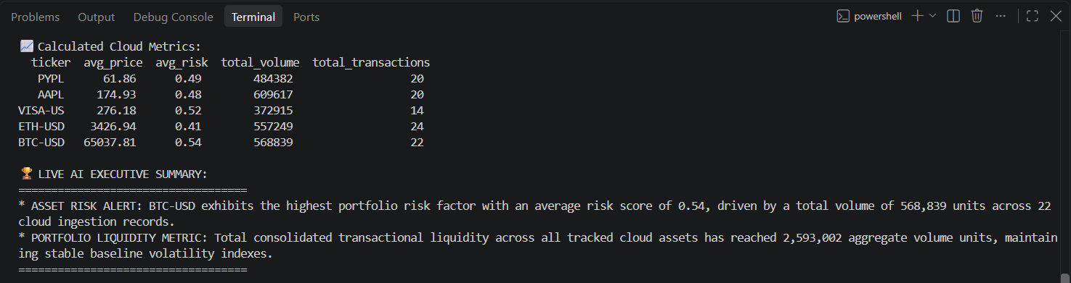
Phase 2: Live AI Executive Summary
What the AI layer does
Challenge solved
Gemini 1.5 Flash reads the computed metrics and flags BTC-USD as the highest-risk asset (avg score 0.54), with 2,593,002 total volume units tracked.
New AQ. prefix API keys broke the URL ?key= format and returned 404 errors. Moving the key into the x-goog-api-key request header fixed it.
Notes:
Show the GenAI layer. Mention the troubleshooting story: key passed in the header instead of the URL resolved the 404s.

Slide 7
Phase 3: Live Dashboard & Risk Insights
0.48
100
baseline portfolio risk score
ingested records
Looker Studio dashboard connected live to BigQuery
Notes:
Dashboard shows risk score, record count, volume split by ticker, and a detail table. The chart on the right comes from the risk report: PYPL and VISA-US show the highest anomaly rates.

Slide 8
Business Question & Recommendation
Question: which asset should the risk team review first?
BTC-USD
PYPL
VISA-US
$36.97B
30.0%
28.6%
Largest capital exposure and highest average risk score (0.54)
Highest high-risk anomaly rate: 6 of 20 records flagged
Second-highest anomaly rate: 4 of 14 records flagged
Recommendation: review BTC-USD exposure limits first, then investigate the PYPL and VISA-US anomalies. Confirm on a larger dataset before acting.
Notes:
Frame the analysis as a decision. Be clear that these findings come from a small simulated sample, so the recommendation is to validate on more data.

Slide 9
Measurable Business Value
1 click
2.5M+
3
Analytics time reduction
Volume units processed
Technical blockers resolved
Ad-hoc SQL scripts and spreadsheet steps replaced by one automated run.
About $39B in simulated capital exposure analysed across crypto and equities, straight from cloud tables.
PowerShell path limits, OS file locks and an API header conflict, fixed to keep the pipeline running reliably.
Notes:
Tie the numbers back to business value. Enterprise data isolation was covered on the architecture slide.

Slide 10
Limitations & Next Steps
Next steps
Current limitations
Data is simulated, not live market data
Only 100 records, about 20 per asset, so anomaly rates are indicative only
Findings show the pipeline works; they are not investment conclusions
1
Scale up
Load thousands of real market rows through the same pipeline.
2
Apply to lending
Track NPA, DPD buckets and collateral risk on loan data.
3
Schedule refresh
Run automatically so dashboards stay current.
4
Publish the code
Share the code and a README on GitHub.
Notes:
Being upfront about limits builds credibility. The lending-data next step connects the project to your day job.

Slide 11
Skills Demonstrated
1
SQL & BigQuery
2
Python & Pandas
Thank you
From raw data to executive insight, automatically.
3
Cloud IAM security
4
GenAI integration
Supriya
5
BI dashboards
6
Business storytelling
Business Analyst | Data Analyst
Notes:
Close with the skills this project demonstrates, then open for questions.

